Slide 1
Reverse complement

Slide 2
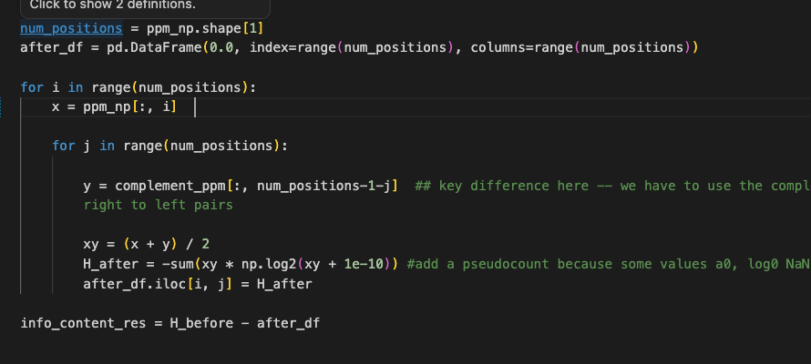
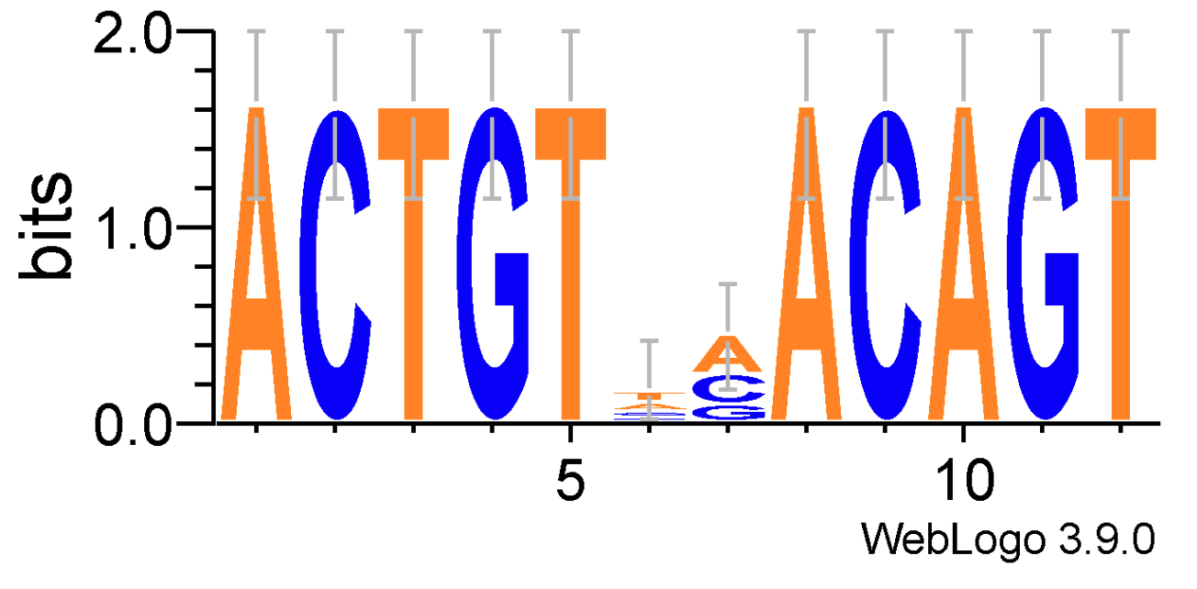
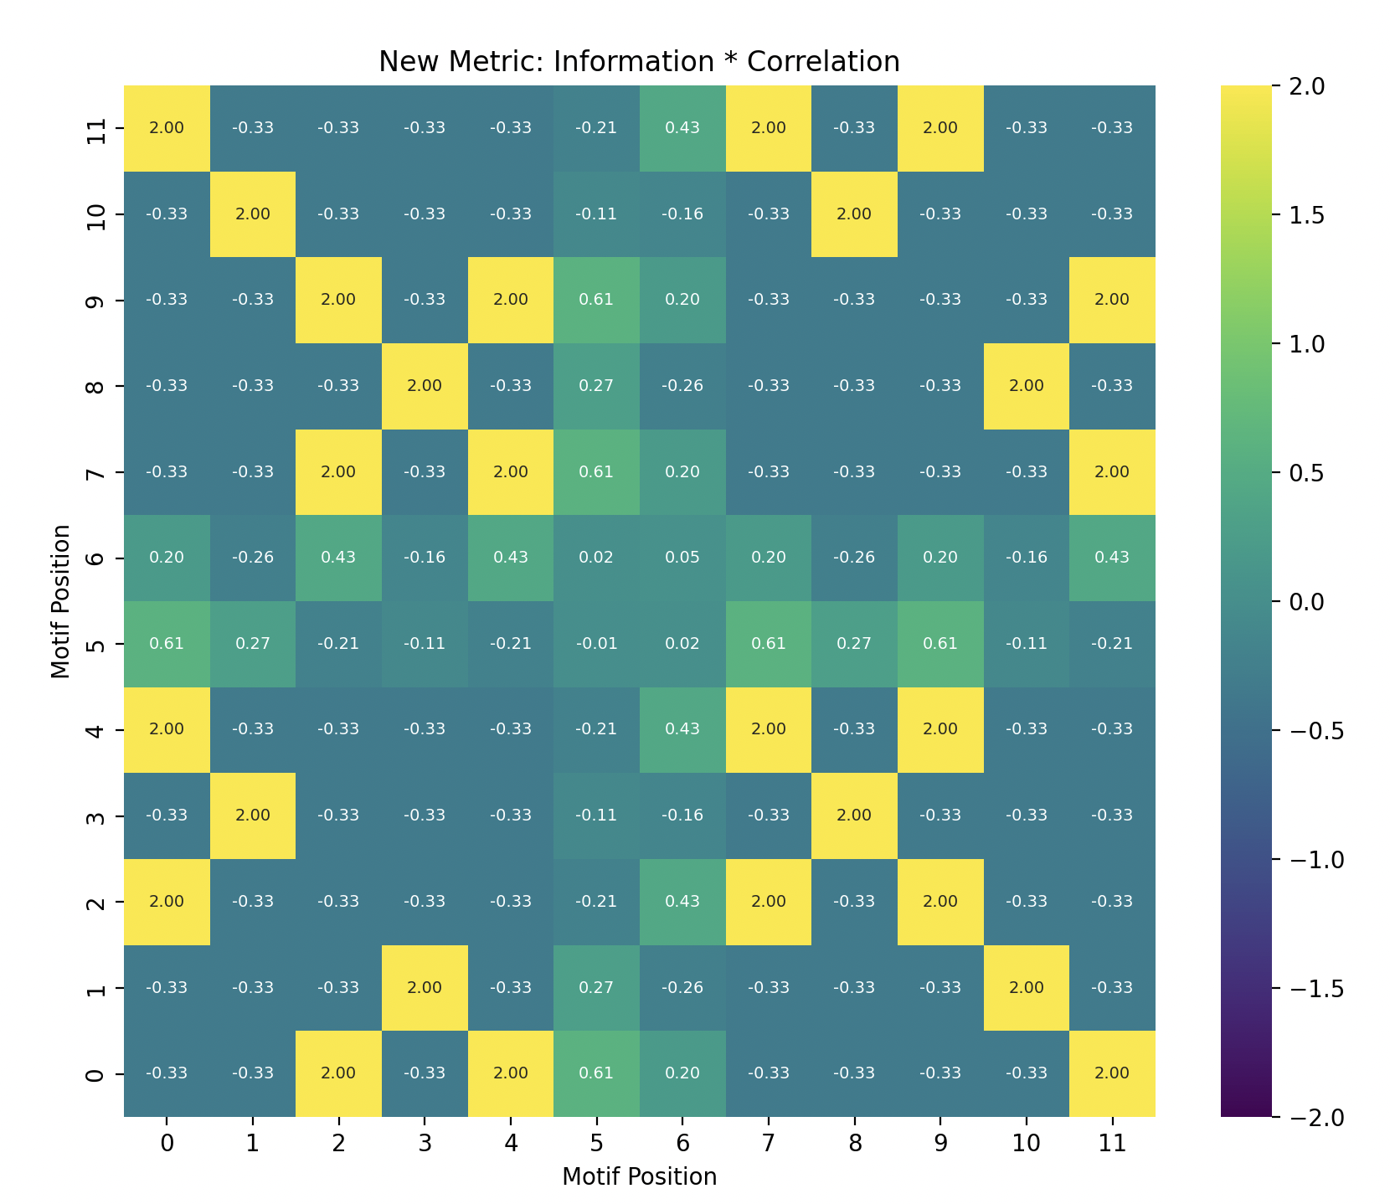
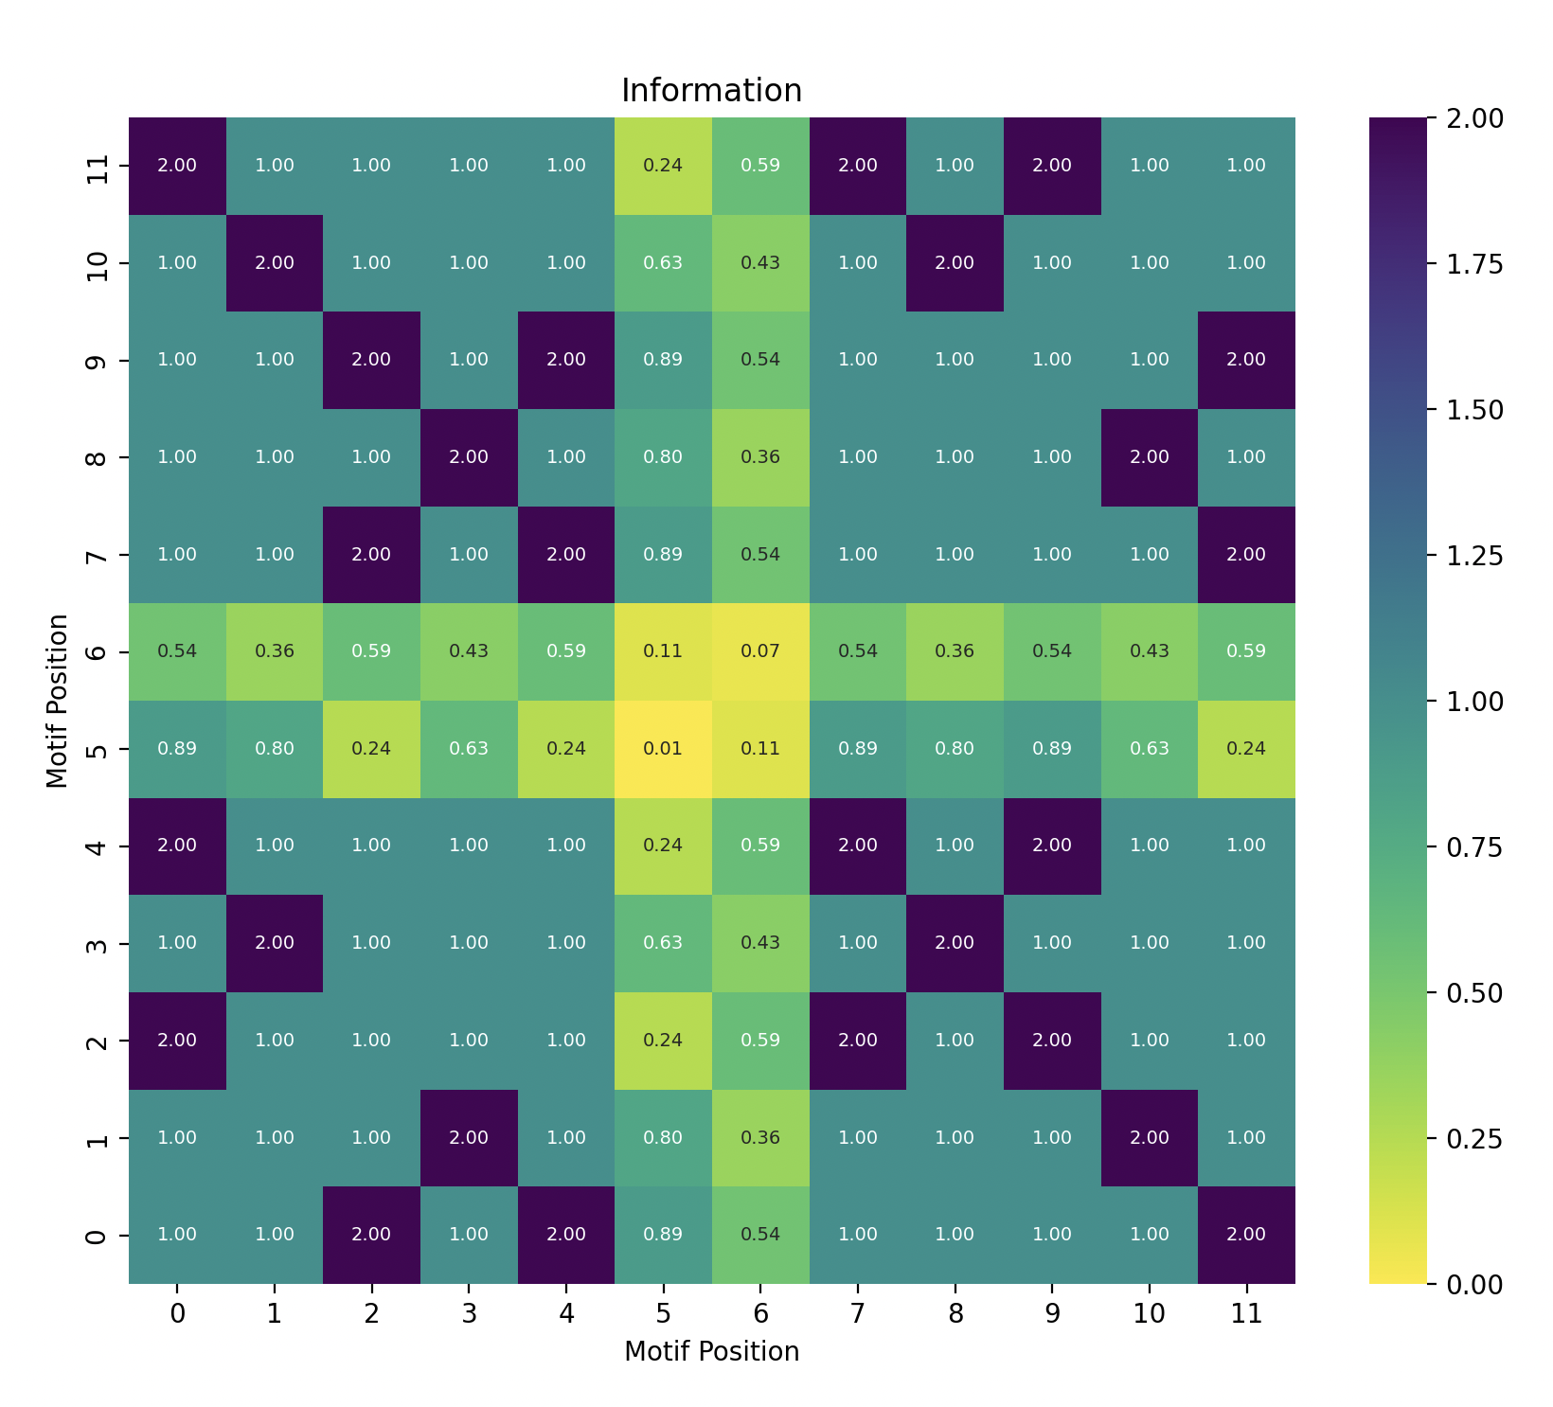
Toy example
ACTGT
Reverse TGTCA
Complement ACAGT

Slide 3
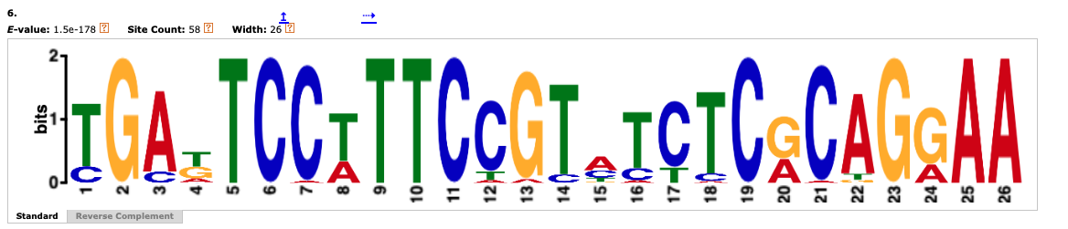
Meme_out_3, number 6
…. TTCC….GGAA

